Slide 1
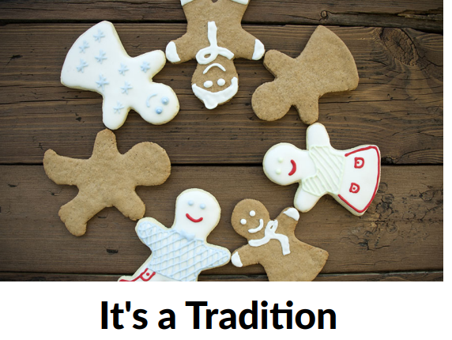
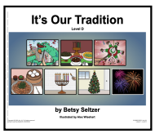
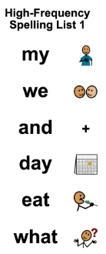
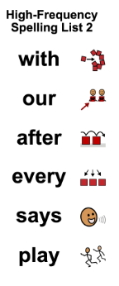
ABC
November 2025
Spotlight on Learning
Monthly Theme
This unit explores the traditions of families from different cultures during the winter holiday season. Through stories and hands-on
activities, students will learn about a variety of traditions. Students will also share their own traditions they have with family or friends.
Monthly Unit Overview
November Reading
Writing - Monthly Word Study
SOCIAL STUDIES
Culture and Holiday
traditions
SCIENCE
Energy/force and motion
All About Fall
MATH
Number Sense
Operations
Measurement
Graphing
Time
Money
UPCOMING EVENTS
11/24-28 Holiday Break

